Slide 1
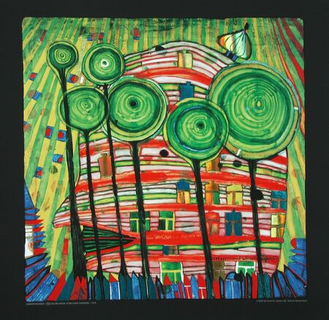
Critical Study on Artist

Slide 2
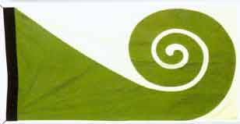
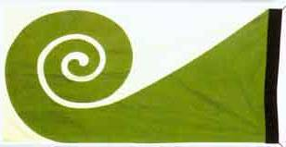
Connector
Write down at least 5 sentences describing the work below:
The shapes are mostly round or curved.
The artist uses the complimentary colours red and green to make them stand out.
The artists markmaking lines are
never straight as nature is not perfect.
There are lots of shapes and lines used creating a patterned effect.
The same shapes are repeated in different sizes.

Slide 3
Level: Critical Study
Level 4C: Full detailed sentences showing excellent understanding of key Art words.
Level 3A: Sentences flow showing good understanding of key Art words.
Level 3B: Sentences may not all flow but show understanding of key Art words.
Level 3C: Sentences do not flow but show some understanding of key Art words. There may be a few spelling mistakes.
Level 2A: One worded answers or very disjointed sentences with some spelling mistakes.

Slide 4
Learning Objective
ALL will write a critical study on the project artist.
ALL will work in their table groups using their skills in: listening, communication, patience, teamwork, creativity and effective participation
MOST will use and understand the key Art words to describe his work.
SOME will explain in more detail by saying why and how the artist makes his work the way he does.

Slide 5
BIG Picture
Connector
Video Clip
Independent Mind Map
Individual critical study time
Peer Assessment
Extension: Group activity

Slide 6
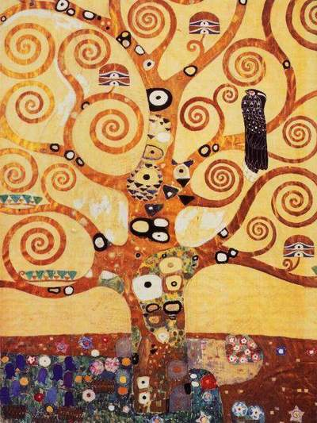
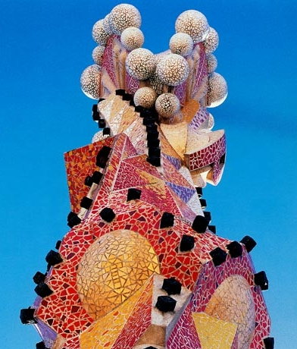
Artist: Friedensreich Hundertwasser
Friendensreich Hundertwasser was an Austrian painter and architect. He was born in 1928 and died in the year 2000. His work was inspired by the environment, philosophy and design. He got much of his ideas from stamps, flags and clothing. Hundertwasser liked artwork by Antoni Gaudi and Gustav Klimt which can be seen in his use of bright colour and basic shapes. He was fascinated with spirals, and called straight lines "the devil's tools".
ABOVE: Friedensrich Hundertwasser
Title: Blobs Grow Beloved in Gardens.
Date: 1975
Materials: Oil paint
Left:
Gustav
Klimt
Left:
Antoni
Gaudi

Slide 7
What are we doing today?
Mood
Content
How the piece of art makes you feel
Introduction to a piece of Art
Critical Studies
Process
Form
The Medium and techniques used by the artist
Description of Art work

Slide 8
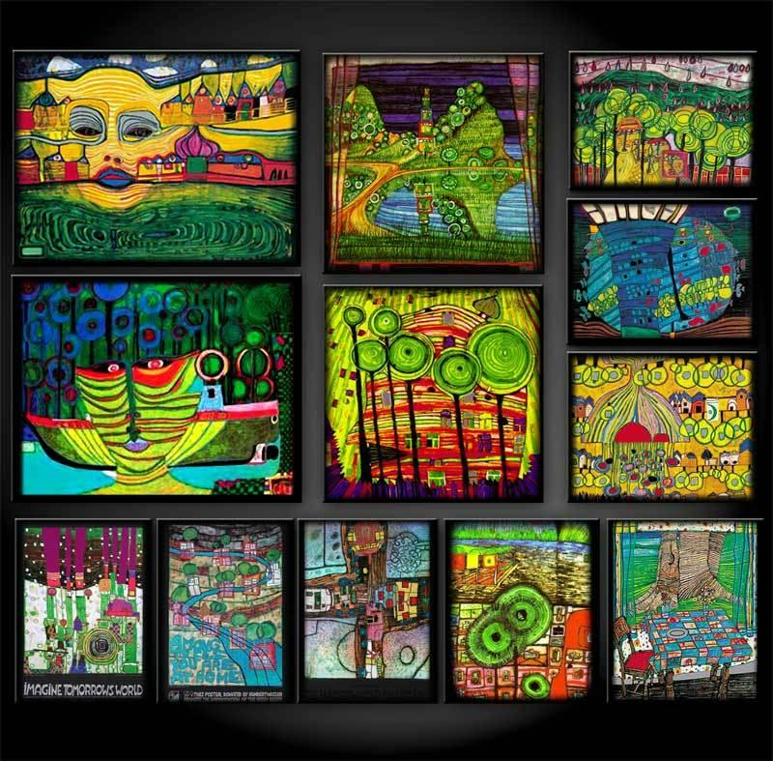
Video Clips
Individually create a mind map during the videos
The True Nature of Hundertwasser's work (http://www.youtube.com/watch?v=3j9wquq7zR8&NR=1)
Hundertwasser's Art Work
(http://www.youtube.com/watch?v=lu2r8RGveFg&feature=related)

Slide 9
1) Content Introduction to art work
1) Who is the artist?
2) What is the title of the painting?
3) When was the painting created?
4) What is in the painting?

Slide 10
2) Form Description of art work
5) What is in the foreground?
6) What is in the background?
7) a)What shapes and lines are used?
b) Why does the artist like these shapes and lines?
8) Describe how size is used in the image?
9) Describe how pattern has been created in the image?

Slide 11
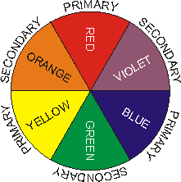
3) Process
The medium and techniques
used by the artist
10) What medium has the artist used?
11) Can you see any brush marks?
12) a)What colours has the artist used?
b) Are these colours primary, secondary, harmonious or complimentary?
13) Why do you think the artist chose these colours in this picture?

Slide 12
4) Mood
How you feel about this piece of art
14) How does the painting make you FEEL?
15) What do you think the artist is trying to make you feel?
16) a)Do YOU like this painting?
b) Why do YOU like or dislike this painting?
17) How will the artists work influence your own artwork and final shoe outcome?

Slide 13
Review: Peer Assessment
On your folder write:
Title | Term | Working At | Working Towards | Target 1 | Target 2
Shoes Around the World Critical Study | 2
Notes:
13

Slide 14
Level: Critical Study- Mark you partners work
Level 4C: Full detailed sentences showing excellent understanding of key Art words.
Level 3A: Sentences flow showing good understanding of key Art words.
Level 3B: Sentences may not all flow but show understanding of key Art words.
Level 3C: Sentences do not flow but show some understanding of key Art words. There may be a few spelling mistakes.
Level 2A: One worded answers or very disjointed sentences with some spelling mistakes.

Slide 15
Set your partner 2 targets (Discuss target ideas on your table) They need to...
Read and check my spellings and writing.
Check my spellings against the key Art
word board.
Make sure my sentences flow.
Make sure I use full detailed sentences.
Make sure I use key Art words correctly.
Make sure I use key
Art words.
!?

Slide 16
Review: Present the Artist
FOR POSITIVE POINTS: Pick the best parts of each persons critical study from their content, form, process and mood section.
Design a presentation, make it visually exciting using colour sugar paper and pens.
Key skills to demonstrate in to days lesson for whole table positive points: Listening, communicating, patience, teamwork, creativity, effective participators

