Slide 1
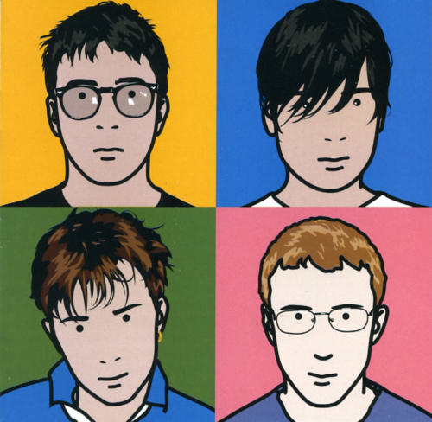
Critical Study on Artist Lesson 3

Slide 2
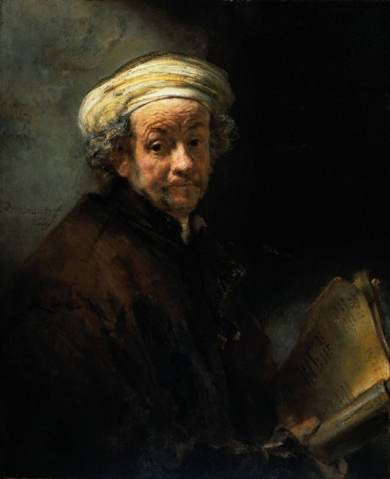
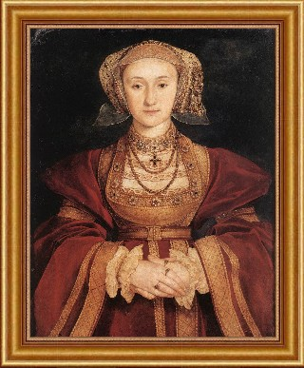
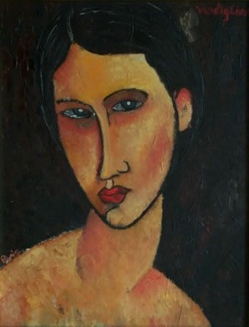
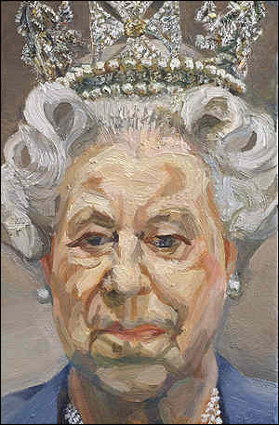
Connector
Write down at least 5 sentences describing how the work below right is different from the other portraits:
The shapes used are simple to make complicated facial features.
The artist uses bright primary colours to stand out.
The artist uses 3 clear block tones.
There is markmaking lines used only to show detail and a black outline.
There is little or no pattern to complicate the picture.

Slide 3
Level: Critical Study
Level 4C: Full detailed sentences showing excellent understanding of key Art words.
Level 3A: Sentences flow showing good understanding of key Art words.
Level 3B: Sentences may not all flow but show understanding of key Art words.
Level 3C: Sentences do not flow but show some understanding of key Art words. There may be a few spelling mistakes.
Level 2A: One worded answers or very disjointed sentences with some spelling mistakes.

Slide 4
Learning Objective
ALL will write a critical study on the project artist.
ALL will work in their table groups using their skills in: listening, communication, patience, teamwork, creativity and effective participation
MOST will use and understand the key Art words to describe his work.
SOME will explain in more detail by saying why and how the artist makes his work the way he does.

Slide 5
BIG Picture
Connector
Video Clip
Independent Mind Map
Individual critical study time
Peer Assessment
Extension: Group activity

Slide 6
The Blur Best of Album Cover By Julian Opie (2000)
This image is an album cover designed for ‘Blur’s Best of Album’ in 2000 by Julian Opie. Opies’ work involves simplifying photos of people into basic shapes, lines and block colour. His work always has a clear black outline.
Opie uses a mixture of media, sometimes he uses paint and other times he will use only the computer to design his images. Opie is inspired by Japanese animation such as Manga.
Above: Album cover in 2000.
Below: Band photo of Blur in 2000.

Slide 7
What are we doing today?
Mood
Content
How the piece of art makes you feel
Introduction to a piece of Art
Critical Studies
Process
Form
The Medium and techniques used by the artist
Description of Art work

Slide 8
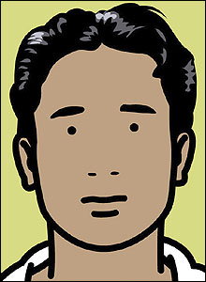
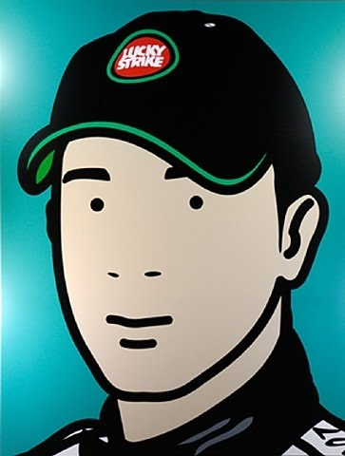
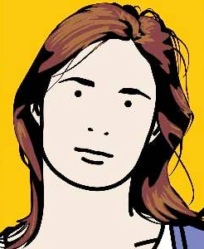
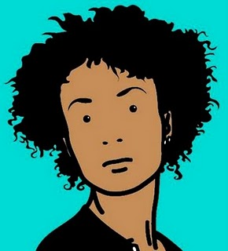
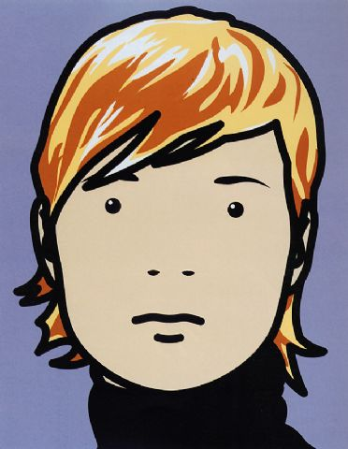
Mind Map
Quote Julian Opie: ‘At the time I was trying to build a face - an identity with the minimum information - Like a logo for a person. I started with a simple circle and looked for what I could add.’

Slide 9
1) Content Introduction to art work
1) What was the picture designed for?
2) What is the name of the artist?
3)What year was the picture produced?
4) What is the picture of?

Slide 10
2) Form Description of art work
5) What is in the foreground?
6) What is in the background?
7) a)What shapes and lines are used?
b) Why does the artist use simple shapes and lines?
8) a) Describe where in the portraits the most markmaking lines and tone is used?
b) How does this help show the identity of the band members?

Slide 11
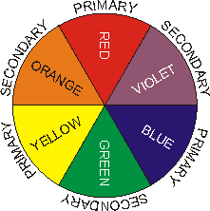
3) Process
The medium and techniques
used by the artist
9) What media does the artist use in
his work?
10) Can you see any brush marks and why?
11) a)What colours has the artist used and why?
b) Are these colours primary, secondary, harmonious or complimentary?
12) Why do you think the artist chose these colours in this picture?

Slide 12
4) Mood
How you feel about this piece of art
13) How does the picture make you FEEL?
14) What do you think the artist is trying to make you feel?
15) a)Do YOU like this picture?
b) Why do YOU like or dislike this picture?
16) How will the artists work influence your own artwork and final portrait outcome?

Slide 13
Review: Peer Assessment
On your folder write:
Title | Term | Working At | Working Towards | Target 1 | Target 2
Shoes Around the World Critical Study | 2
Notes:
13

Slide 14
Level: Critical Study- Mark you partners work
Level 4C: Full detailed sentences showing excellent understanding of key Art words.
Level 3A: Sentences flow showing good understanding of key Art words.
Level 3B: Sentences may not all flow but show understanding of key Art words.
Level 3C: Sentences do not flow but show some understanding of key Art words. There may be a few spelling mistakes.
Level 2A: One worded answers or very disjointed sentences with some spelling mistakes.

Slide 15
Set your partner 2 targets (Discuss target ideas on your table) They need to...
Read and check my spellings and writing.
Check my spellings against the key Art
word board.
Make sure my sentences flow.
Make sure I use full detailed sentences.
Make sure I use key Art words correctly.
Make sure I use key
Art words.
!?

Slide 16
Review: Present the Artist
FOR POSITIVE POINTS: Pick the best parts of each persons critical study from their content, form, process and mood section.
Design a presentation, make it visually exciting using colour sugar paper and pens.
Key skills to demonstrate in to days lesson for whole table positive points: Listening, communicating, patience, teamwork, creativity, effective participators

