Slide 1
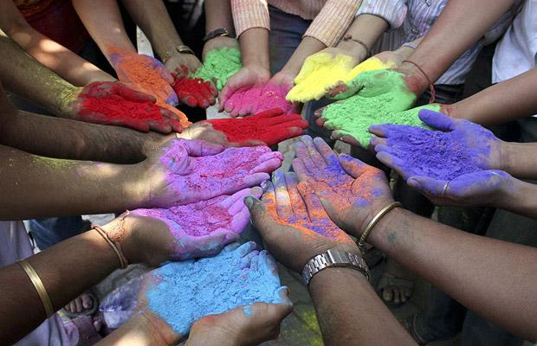
Colour and Culture Lesson 2

Slide 2
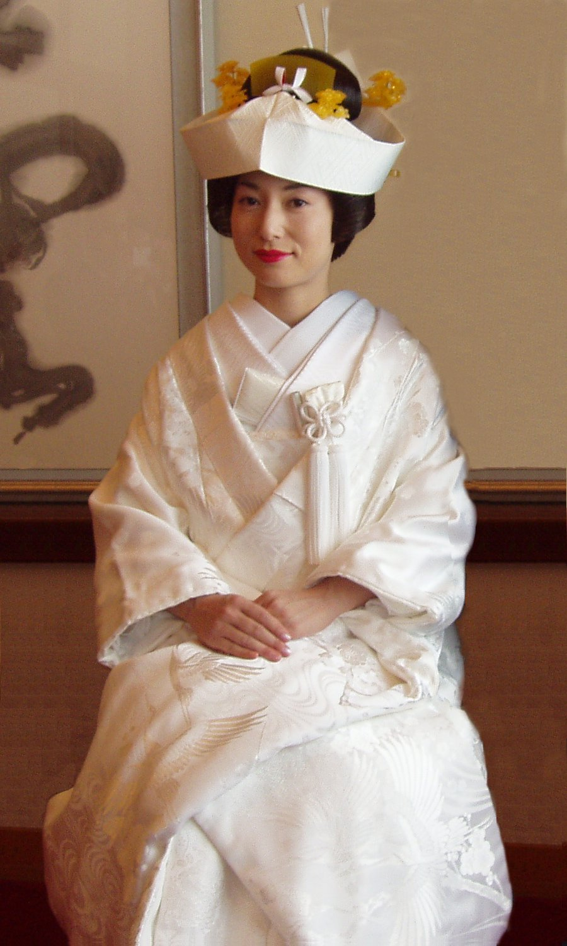
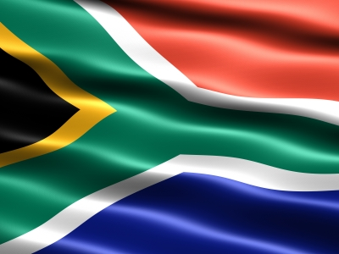
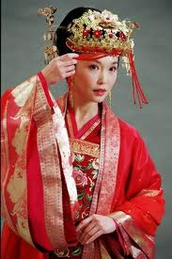
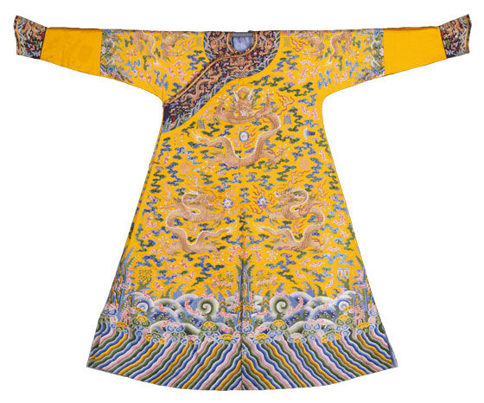
Connector: In 2s or 3s- Card sort the picture to the culture! Why do you think that colour represents that culture?
Japan
India
China
Vietnam
South Africa

Slide 3
India
China
Japan
South Africa
Vietnam

Slide 4
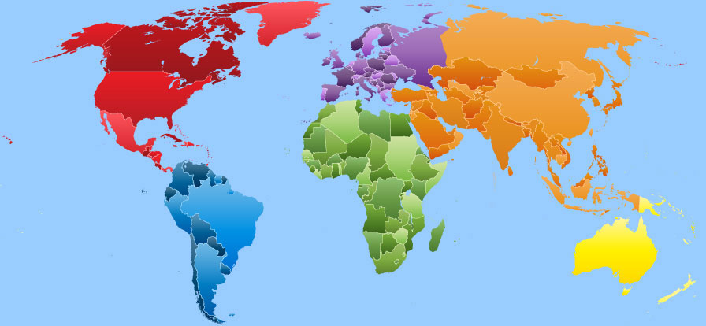
BIG Picture
Connector
Mind map
Indepedent Critical Study
Peer assess
Prepare table presentations
Present presentations
Review

Slide 5
Learning Objective
All will write a critical study on a culture.
All will understand that cultures use colour to represent them.
Most will understand that cultures use colour to represent their festivals, faith or personal feelings.
Some will be able see how cultures use the same colours for similar or different reasons.

Slide 6
China: Red
The ancient and the modern Chinese people cherish the colour of red. It symbolizes Good luck. The colour is used on the eve on New Year and weddings. People pack the gifts in red colour during the New Year to bring good luck in the coming year.
It is also a colour of wedding in Chinese culture. Their wedding dresses are usually made out of silk. The idea is based on the belief that wearing red dress on the day of a wedding will help the couple not get any bad luck.
The colour is believed to bring good luck, happiness and joy in Chinese culture. The Chinese relate red to fire and the energy it brings. Red is traditionally considered as colour that reflects good fortune and opportunity for a good and happy life.
In India and Vietnam red is also used for wedding dresses to symbolise good luck.

Slide 7
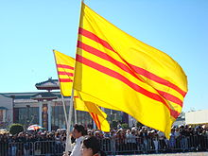
Vietnam- Yellow
Vietnamese also consider yellow with royalty. Because back in time, only emperors (rulers of Vietnam) were allowed to wear yellow. The colour yellow also became symbol of the country through the flag which
is yellow with three red stripes, designed by Emperor Thành Thái
in 1890 and was used by Emperor Bảo Đại in 1948. The emperors robes would be made from silk.
But today, yellow also represents happiness and change. During ‘Tet’ which is New year, homes of Vietnamese families are decorated with ‘Hoa Mai’ which are yellow blossoms symbolizing the arrival of a new season of spring and joy.
The Chinese also identify the colour yellow with royalty or power.

Slide 8
Japan-White
Japan use white reflect “beginnings” or “ends” which can be translated into birth or death. To pay respect to her new family and parents, Japanese brides are required to wear a white kimono robe called “shiro-maku” (meaning white and pure). The white signifies the death of her home life with her parents and a new life with her husband.
Kimonos are made from one piece of fabric and is usually made using silk.
Kimonos became especially popular in the Heian period (894-1185CE) amongst Japanese women, which also identified ages, ranks and ceremonies. Noble women wore short white kimono tops back then and white eventually became a wedding colour.
White is also used in wedding dresses in many western cultures to symbolise new beginnings, but rather its the joining of two families.

Slide 9
South Africa: Rainbow Nation
The current national flag for South Africa is made up of 6 colours, red, white, green, blue, black and a golden yellow.
The flag was designed by Mr. Fred Bronwell 1994. The flag has become a symbol of the unity and of the different race groups in South Africa. The flag was designed using a combination of colours from historic South African flags. Flags are usually made out of cotton or polyester.
The flag was not designed with the each of the colours to represent a different part of South Africa. The Y or V form of the flag was chosen to symbolize the unity, or coming together, of South Africa's different groups.
Many South Africans choose to feel the colours represent something or an event in history. The common idea of what the colours reflect are:
Red: bloodshed, White: white population, Blue: skies or the ocean, since South Africa is surrounded by 2 oceans, Yellow: minerals, Green: agriculture and land, Black: the non-white population or Mr Mandela
"We enter into a society in which all South Africans, both black and white, will be able to walk tall, without fear in their hearts, assured of their inalienable right to human dignity – a rainbow nation at peace with itself and the world." Nelson Mandela, Inaugural Address, Pretoria 9 May 1994.

Slide 10
India: Festival of Colour
The colourful festival of Holi is celebrated on Phalgun Purnima which comes on the last day of winter. Holi festival has an ancient origin and celebrates the triumph of 'good' over 'bad'. The colourful festival bridges social gaps and gets people to renew friendships. On this day, people hug and wish each other 'Happy Holi'.
The colours come from a coloured powder that they also use to dye water to pour over people in the celebration. The colourful festival Holi celebration begins with lighting up of bonfire on the Holi eve. Many legends and stories linked to Holi celebration are told. People rub the colourful 'gulal' and 'abeer' on each others' faces and cheer. The bright colours celebrate the bright colour that is to come from the start of Spring. The bright colours represent joy coming back into peoples lives after winter.

Slide 11
Table groups create a Mind map on their culture:
Mood
Content
How the item/ artefact makes you feel
Introduction to the item/ artefact
Critical Studies
Process
Form
The Medium and techniques used by the culture
Description of item/ artefact

Slide 12
1) Content Introduction to art work
1) What is the item?
2) What was the item designed for?
3) What is the name of the culture?
4) What is the item used for in the culture?

Slide 13
2) Form Description of art work
5) a) What is the main colour of the item?
b) What does the colour represent about the culture?
6) a)What shapes and lines are used in the pattern?
b) How do you think the shapes and lines in the pattern represent the culture?

Slide 14
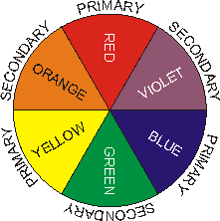
3) Process
The medium and techniques
used by the artist
7) What media is the item made out of?
8) a) List the colours used in the item?
b) Are these colours primary, secondary, harmonious, complimentary or tonal?
9) Why do you think the culture chose these colours in the item?
10) a)Are there any other cultures that use the same colour?
b) Does the colour to this culture have the same meaning to them?

Slide 15
4) Mood
How you feel about this piece of art
11) How does the item make you FEEL?
12) What do you think the culture is trying to make you feel?
13) a)Do YOU like this item?
b) Why do YOU like or dislike this item?
14) What colour would you use to represent you and why?

Slide 16
Review: Peer Assessment
On your folder write:
Title | Term | Working At | Working Towards | Target 1 | Target 2
Colour and Culture Critical Study
Notes:
16

Slide 17
Level: Critical Study- Mark you partners work
Level 4C: Full detailed sentences showing excellent understanding of key Art words.
Level 3A: Sentences flow showing good understanding of key Art words.
Level 3B: Sentences may not all flow but show understanding of key Art words.
Level 3C: Sentences do not flow but show some understanding of key Art words. There may be a few spelling mistakes.
Level 2A: One worded answers or very disjointed sentences with some spelling mistakes.

Slide 18
Set your partner 2 targets (Discuss target ideas on your table) They need to...
Read and check my spellings and writing.
Check my spellings against the key Art
word board.
Make sure my sentences flow.
Make sure I use full detailed sentences.
Make sure I use key Art words correctly.
Make sure I use key
Art words.
!?

Slide 19
Review: Present the Artist
FOR POSITIVE POINTS: Pick the best parts of each persons critical study from their content, form, process and mood section.
Design a presentation, make it visually exciting using colour sugar paper and pens.
Key skills to demonstrate in to days lesson for whole table positive points: Listening, communicating, patience, teamwork, creativity, effective participators

Slide 20
Review: FOR POSITIVE POINTS:
What was the item designed for?
What colour is the item?
Why did the culture choose this colour to represent the culture?
What do you think the culture wants you to feel when you see their colour?
What colour would you choose to represent you? And why?

