Slide 1
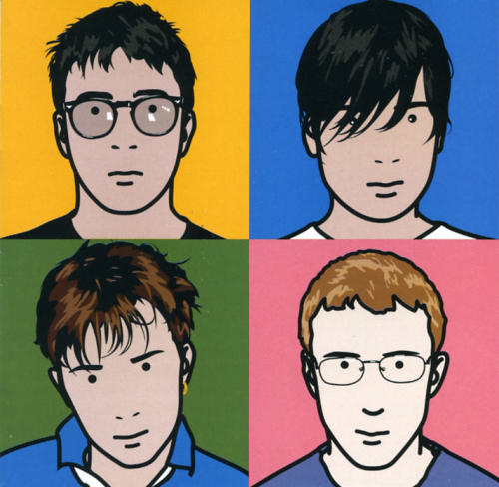
Critical Study on Artist Lesson 3

Slide 2
Learning Outcomes
Level 3C-3B
All: Will be able to give facts about the artist and basically describe it.
Level 3A-4C
Most: will be able describe the work and explain the processes and techniques the artist has used.
Level 4B-4A
Some: will be able to explain how the artwork makes them feel and explain what they think the artist was trying to explain about the people in the portrait through his work.

Slide 3
Connector: In the following slides pick out which is the GOOD and which is the BAD sentence. Explain what makes the sentence strong and what makes them weak.

Slide 4
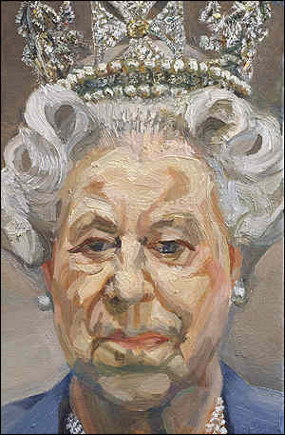
Which is the stronger sentence and why?
The artwork is a portrait of Queen Elizabeth II who is queen on England.
Qeen
It is the queen.

Slide 5
Which is the stronger sentence and why?
The artwork is a portrait of Queen Elizabeth II who is queen on England.
qeen
It is the queen.

Slide 6
Which is the stronger sentence and why?
colors are dull
Grey colour and some blue make her look old.
The colour grey is used in
the background and blue in her
clothes. Blue and grey look
similar making the picture look soft and calm which I think maybe
what the artist wants you to
think of the queen.

Slide 7
Which is the stronger sentence and why?
colors are dull
Grey colour and some blue make her look old.
The colour grey is used in
the background and blue in her
clothes. Blue and grey look
similar making the picture look soft and calm which I think maybe
what the artist wants you to
think of the queen.

Slide 8
Which is the stronger sentence and why?
grey make me feel bored
The colour grey makes me feel gloomy. I think the grey
represents age and how
long the queen has been on
the throne in England.
I feel down when I look at
the colour grey.

Slide 9
Which is the stronger sentence and why?
grey make me feel bored
The colour grey makes me feel gloomy. I think the grey
represents age and how
long the queen has been on
the throne in England.
I feel down when I look at
the colour grey.

Slide 10
Discuss: What makes GOOD Sentence Starters?
Discuss: What makes BAD Sentence Starters?
The item is….
The artefact…
The South African flag…
It was designed…
I feel…
It reflects…
It looks…
The colours make me feel…
No…
Yes…
Looks like…
Item is…
Colours look…

Slide 11
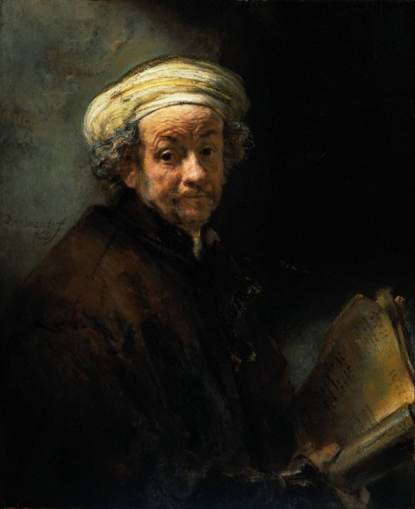
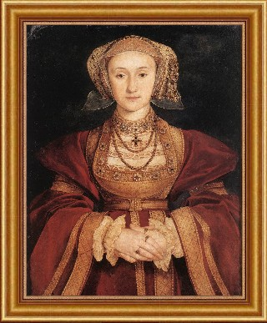
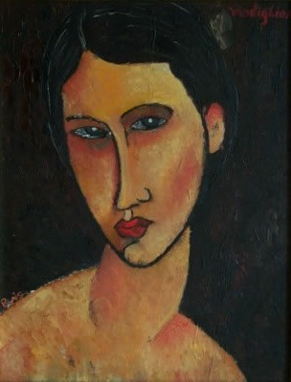
Sentence Forming
Write down at least 5 sentences describing how the work below right is different from the other portraits:
The shapes used are simple to make complicated facial features.
The artist uses bright primary colours to stand out.
The artist uses 3 clear block tones.
There is markmaking lines used only to show detail and a black outline.
There is little or no pattern to complicate the picture.

Slide 12
BIG Picture
Connector
Independent sentence forming
Individual critical study time
Peer Assessment
Extension: Group activity

Slide 13
The Blur Best of Album Cover By Julian Opie (2000)
This image is an album cover designed for ‘Blur’s Best of Album’ in 2000 by Julian Opie. Opies’ work involves simplifying photos of people into basic shapes, lines and block colour. His work always has a clear black outline.
Opie uses a mixture of media, sometimes he uses paint and other times he will use only the computer to design his images. Opie is inspired by Japanese animation such as Manga.
Above: Album cover in 2000.
Below: Band photo of Blur in 2000.

Slide 14
What are we doing today?
Mood
Content
How the piece of art makes you feel
Introduction to a piece of Art
Critical Studies
Process
Form
The Medium and techniques used by the artist
Description of Art work

Slide 15
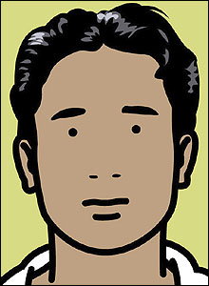
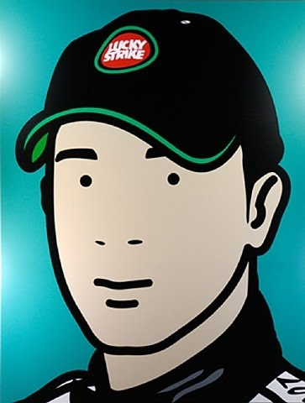
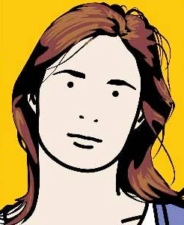
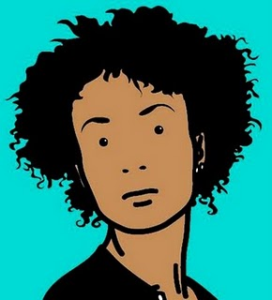
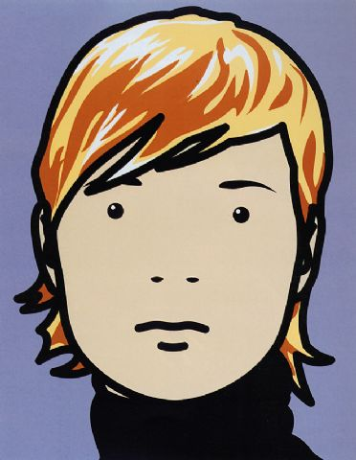
Quote Julian Opie: ‘At the time I was trying to build a face - an identity with the minimum information - Like a logo for a person. I started with a simple circle and looked for what I could add.’

Slide 16
1) Content Introduction to art work
1) What was the picture designed for?
2) What is the name of the artist?
3)What year was the picture produced?
4) What is the picture of?

Slide 17
2) Form Description of art work
5) What is in the foreground?
6) What is in the background?
7) a)What shapes and lines are used?
b) Why does the artist use simple shapes and lines?
8) a) Describe where in the portraits the most markmaking lines and tone is used?
b) How does this help show the identity of the band members?

Slide 18
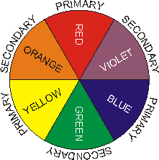
3) Process
The medium and techniques
used by the artist
9) What media does the artist use in
his work?
10) Can you see any brush marks and why?
11) a)What colours has the artist used and why?
b) Are these colours primary, secondary, harmonious or complimentary?
12) Why do you think the artist chose these colours in this picture?

Slide 19
4) Mood
How you feel about this piece of art
13) How does the picture make you FEEL?
14) What do you think the artist is trying to make you feel?
15) Why is this artist interesting to study?
16) What have you learnt about the artist?
17) What do you now think of this artist?
18) Who will you draw and paint in your Julian Opie style painted final pice?

Slide 20
Level: Critical Study- Mark you partners work
Level 4B: Full detailed sentences showing excellent understanding of key Art words and clear opinions using a range of vocabulary.
Level 4C: Sentences flow showing good understanding of key Art words and their opinion using some vocabulary.
Level 3A: Sentences may not all flow but show understanding of key Art words.
Level 3B: Sentences do not flow but show some understanding of key Art words. There may be a few spelling mistakes.
Level 3C/3B: One worded answers or disjointed sentences with some spelling mistakes.
Level 3C: One worded answers or very disjointed sentences with many spelling mistakes.

Slide 21
Set your partner 2 targets (Discuss target ideas on your table) They need to...
Read and check my spellings and writing.
Check my spellings against the key Art
word board.
Make sure my sentences flow.
Make sure I use full detailed sentences.
Make sure I use key Art words correctly.
Make sure I use key
Art words.
!?

Slide 22
Review: Present the Artist
FOR POSITIVE POINTS: Pick the best parts of each persons critical study from their content, form, process and mood section.
Design a presentation, make it visually exciting using colour sugar paper and pens.
Key skills to demonstrate in to days lesson for whole table positive points: Listening, communicating, patience, teamwork, creativity, effective participators

