Slide 1
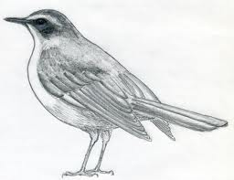
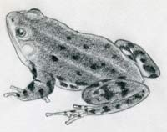
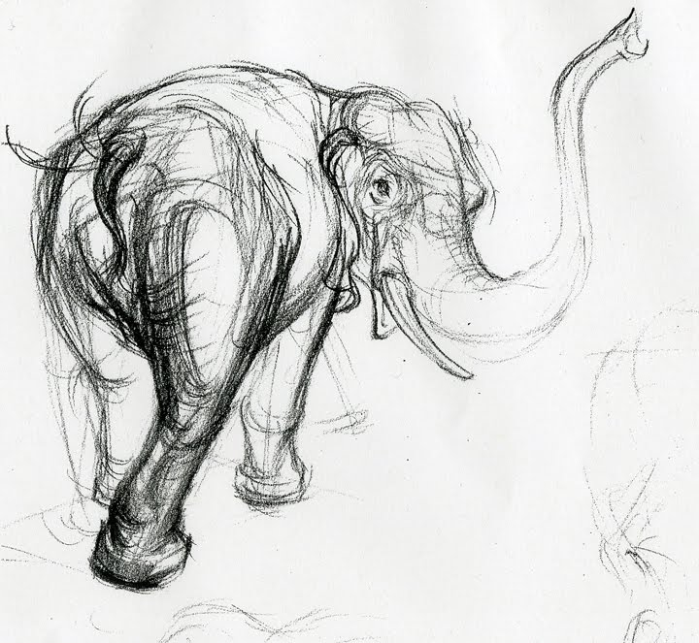
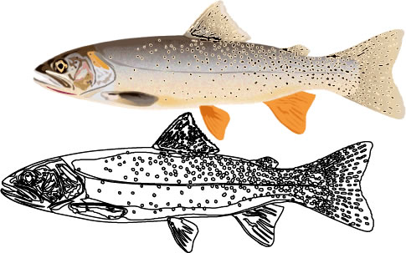
Trip Review
Images of Nature

Slide 2
Connector: Discussion
Discuss with the person next you:
What did you LIKE about the Natural History Museum?
What did you DISLIKE about the Natural History Museum?
But... explain why?

Slide 3
Learning Outcomes
All will complete a review of their trip to the Natural History Museum.
All will complete a review of the work form the exhibition of Year 10 and 11 to meet the Arts Award criteria B:
B) ‘Arts Event’ like going to a museum or gallery like to review the work and exhibit and share our opinions.
Most will explain their answers by saying why they think what they do.
Some will link others opinions to their own and find the similarities and differences between them.

Slide 4
BIG Picture
Connector
Class discussion
Share your reviews/drawings with the people on your table.
Video clip
Review: David Attenborough’s opinions on the Natural History Museum.
Review: Yr 10/11 Exhibition

Slide 5
Why do you think you reviewed the artwork in the museum?
exploring your OWN opinions
forming your OWN views (likes/dislikes) in Art
practice evaluating OTHER peoples (artists) work
understand that their are LINKS between subjects e.g. Science and Art
understand HOW Art can be used in the REAL world e.g. Scientific drawing studies of plants/animals

Slide 6
How does this link to your Myself Project?
create your OWN opinions
appreciate and RESPECT different artwork even if we do NOT like it
understand and appreciate that we all have different opinions even if we do NOT agree
understand that their maybe links between the subjects and hobbies that we ENJOY
understand HOW we can use the links between subjects and hobbies we enjoy in later life

Slide 7
Sharing Your Reviews
1) MAKE SURE YOUR NAME IS ON ALL YOUR WORKSHEETS.
2) Swope your Natural History Museum trip worksheet with another person on your table.
3) Look at their drawings and read their comments from the trip.
4) Write a summary of their review onto your NEW worksheet.
5) Write in full detailed sentences.
6) Repeat this a second time. You MUST share your reviews with at least 2 people!

Slide 8
Review: Watch this clip
In the video is a man called: David Attenborough.
1) What is he well known for?
Documentaries on different environments, plants and animals, some of which without him would not have been discovered.
2) Why is he a suitable person to review the Natural History Museum?
The Natural History Museum like David Attenborough shows the public environments, plants and animals that have been discovered.
Watch: http://www.nhm.ac.uk/index.html

Slide 9
Review:
On you NEW SECOND sheet:
Review David Attenborough’s review on the
Natural History Museum.
Use your OWN words and opinions.
Write in full detailed sentences.

