Slide 1
Bronze Level 1 Arts Award

Slide 2
BIG Picture
Class discussion what is the Arts Award
Teamwork activity in planning a drawing demonstration.
Review progress made so far in the Arts Award.

Slide 3
There are 4 Sections to the Arts Award
A) ‘Take Part in an Arts Activity’ like an art competition.
B) ‘Arts Event’ like going to a museum or gallery like to review the work and exhibit and share our opinions.
C) ‘My Arts Hero/Heroine’ researching an artist and the person who inspires you, create a portrait of the person who inspires you.
D) ‘Arts Apprenticeships’ where you work with an Art specialist like your teacher to demonstrate your knowledge in e.g. a drawing demonstration.
Which one in the criteria do you think we have already achieved and why?
Which criteria are we working on now in class?

Slide 4
Learning Outcomes
All will plan for their drawing demonstration to work towards their Arts Apprenticeships to meet criteria D.
Most will have answered all the questions from the worksheet and have a good idea about their demonstration.
Some will have very clearly defined roles and will plan and make resources for the demonstration.

Slide 5
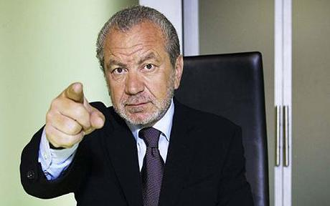
Demonstration: Arts Apprentices’
Table 1 + Fariya will demonstrate drawing the nose.
Table 2+ Arham will demonstrate drawing the eyes.
Table 3+ Sukhdeep will demonstrate drawing the lips.
Table 4+ Meerab will demonstrate drawing the ears.
Your job is to show your class how to draw parts of the human face accurately –good luck teams!

Slide 6
Planning
Discuss in your groups, make sure everyone is included.
Answer questions A and B.
Complete planning box A and B.
Draw an exemplar drawing of your given facial feature e.g. nose.

Slide 7
Review
Independently answer questions D-F!

